Slide 1
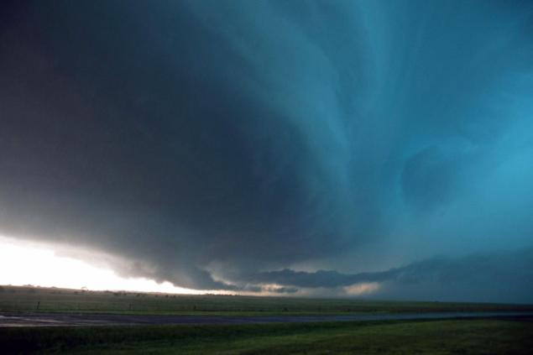
Towards A Weather Ready Nation
Public Education, Engagement and Communication on Extreme Weather Events
Shakila Merchant
NOAA-CREST & CREST Institute
Education and Communication Session
8th Annual CREST Symposium
June 5-6, 2013

Slide 3
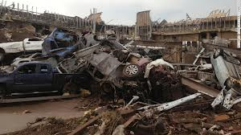
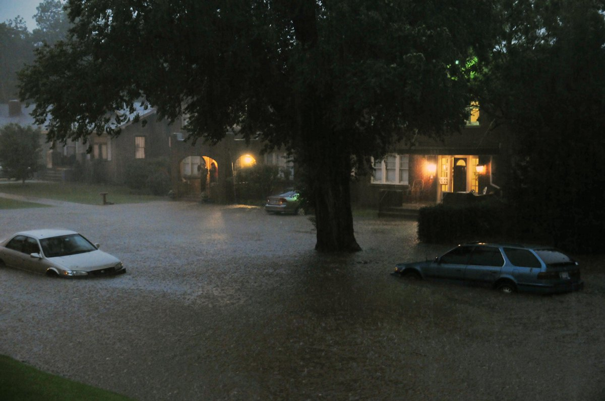
May 2013 witnessed one of the worst Tornadoes season in the Tornado Alley
5 Storms in less than 2 weeks
100s dead
Thousands became homeless
Billions of property loss

Slide 4
Sydnee (7 Months) Karrina Vargyas (4 years) were among the 10 kids who lost their lives..
Both Syndee and Karrina were home with their mom when the storm ripped their home apart and the gusty winds casued blunt injuries to these two tender souls

Slide 5
Source – National Weather Service

Slide 6
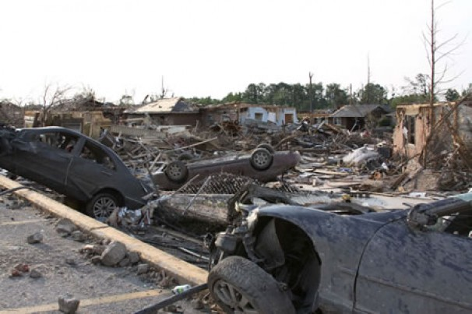
NOAA a mission driven agency NWS mission is to
Translate our best science & expertise to sustained societal benefits

Slide 7
Services Roadmap
We issue forecasts & warnings to support decisions
We support decisions with forecasts, warnings & environmental information
2010
2015
2020
Data
Forecasts
Warnings
Rigid & rule based
thresholds
Real Impacts on Life
Relevant to Decisions
Enabling Decisions
Impact Based Decision Support Services (IDSS)
Source: Dr. Jason Tuell, Office of Climate, Water and Weather Services

Slide 8
Some (my) mind-boggling questions
Are these natural events more impactful and beyond human-based scientific predictions?
Could public understanding and a more literate society help us save more lives and less economic losses?
What more could the agencies, scientists, researchers do to connect the dots
Are we better connected (social media) for understanding the environmental impacts that drives these weather events….
OR…better communicated for entertainment…
Are there too many weather prediction models – that might challenge the right and timely decision making process during extreme weather events?
HOW do we increase the public engagement and/or further educate/literate society to face these environmental challenges..?

