Slide 1
Improving hydrological modeling in NYC reservoir watersheds using remote sensing evapotranspiration and soil moisture products
NOAA-CREST Symposium
June, 6th 2013
Dr. Naira Chaouch
Research scientist, NOAA-CREST
Nir Krakauer, Marouane Temimi, Adao Matonse (CUNY) Elliot Schneiderman, Donald Pierson, Mark Zion (NYCDEP)

Slide 2
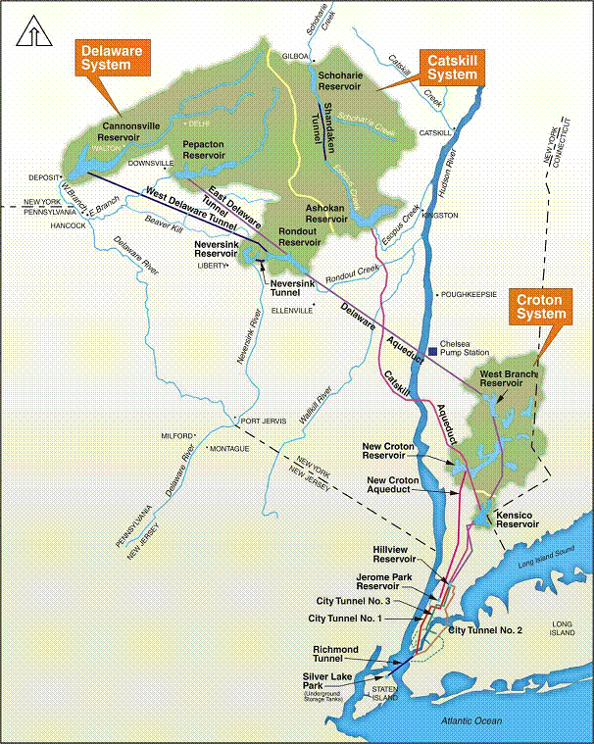
Partners/Problem
NYC manages a 60-120 year old system of reservoirs, aqueducts, tunnels supplying 9 million people ( 1 billion gallons/day)
Water quantity: Drought now rarely poses serious problems, but earlier snowmelt, hotter summers are threats
Water quality: function of rain rate, soil moisture as well as land use
Accurate estimate of each process of the water cycle is important for better managing water resources in terms of quantity and quality
NYC DEP Hydrological models are calibrated and verified through comparisons of the simulated and measured discharge

Slide 3
objectives
Improve understanding of water budget during low-flow periods:
Equifinality is a challenge – models may perform well under current conditions but do poorly for processes that aren't calibrated – or for future conditions
Enable water managers to make use of remote sensing information
Use remote sensing products to calibrate/verify parameters in watershed hydrological models
Improved watershed model representation of water quantity and quality

Slide 4
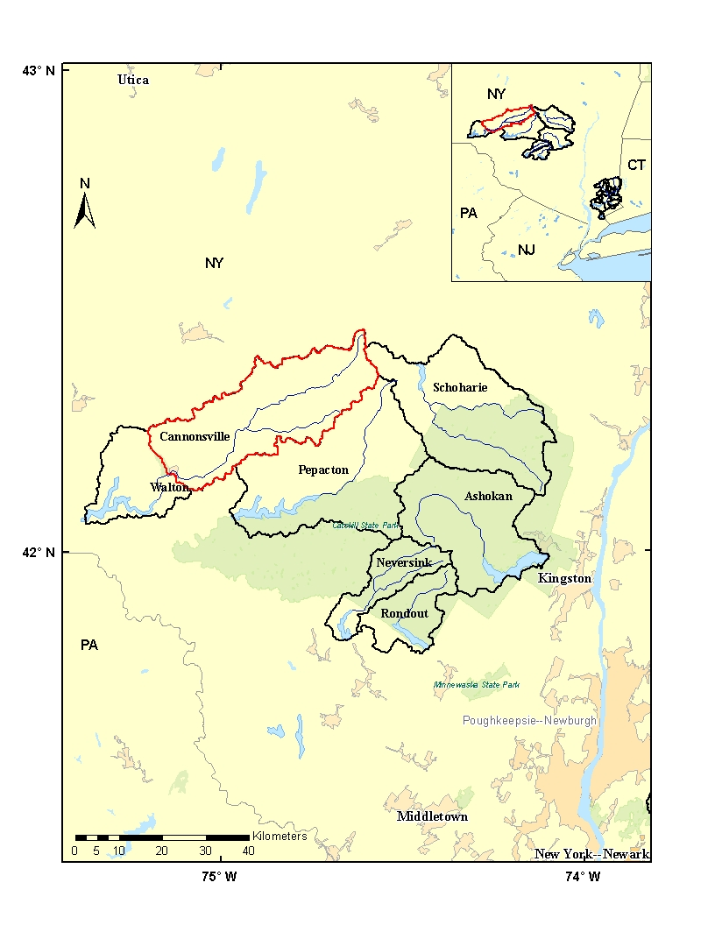
Study area
West Branch Delaware River:
Area of 85,925 ha
Elevations : 370 to 1020 m (590m average)
80 % forested,
14% agriculture (dairy)
No water diversions, transfers or flow regulation

Slide 5
GWLF model
Unsaturated zone
(water & sediment)
Shallow saturated zone
Groundwater discharge
Deep saturated zone
Generalized Watershed Loading Functions (GWLF) model:
Lumped parameter model
Simulate streamflow, nutrients and sediment loads on a watershed scale
Watershed is considered as a composite of # hydrological response units depending on land uses and soil wetness

Slide 6
Remote sensing data
Evapotranspiration: MODIS (MOD16)
8-day composite, 1 km² spatial resolution
Based on Penman-Monteith approach
MODIS land cover, albedo, LAI, FPAR, daily meteorological
reanalysis data from GMAO
Land Parameter Retrieval MODEL (LPRM) root zone soil moisture product:
Derived from AMSR-E data through the assimilation of the LPRM/AMSR-E soil moisture into the 2-Layer Palmer Water Balance Model
Spatial resolution 0.25º
Assess GWLF model (default calibration) and new calibrated

Slide 7
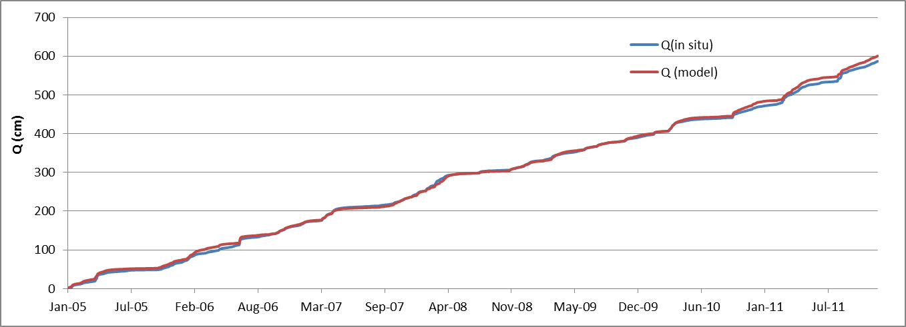
Streamflow : in situ Vs. Model

Slide 8
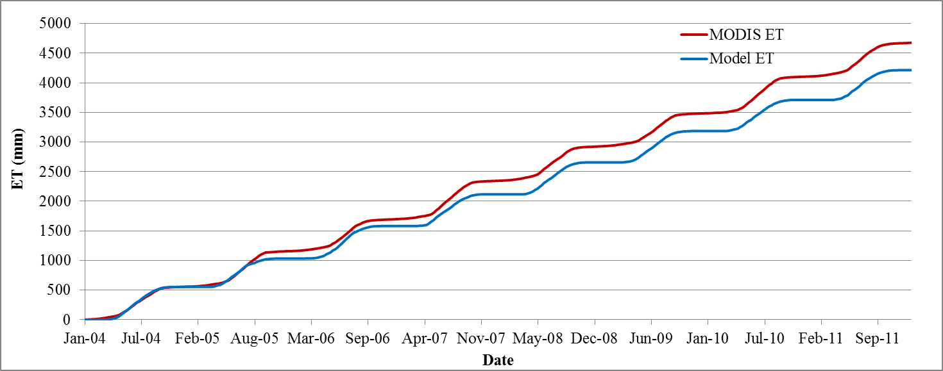
Evapotranspiration: Model Vs. MODIS

Slide 9
Year | Precipitation (mm) | Model ET (mm) | MODIS ET (mm) | Model Q (mm) | In situ Q (mm)
2005 | 566.3 | 441.1 | 526.2 | 128.9 | 131.3
2006 | 876.2 | 501.9 | 459.5 | 347.9 | 444.2
2007 | 685.0 | 510.9 | 570.2 | 168.8 | 167.6
2008 | 644.4 | 506.4 | 497.0 | 134.8 | 131.2
2009 | 843.5 | 487.2 | 470.5 | 319.9 | 340.4
2010 | 773.8 | 484.2 | 553.8 | 283.3 | 241.8
2011 | 971.0 | 474.6 | 483.1 | 538.2 | 534.1

Slide 10
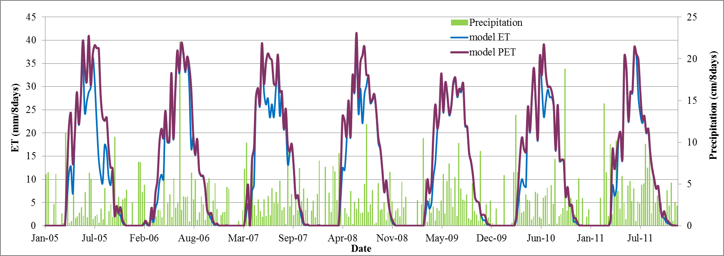
Model : Potential evapotranspiration Vs evapotranspiration
Underestimation of the summer ET results from land surface controls and not from available energy (PET)

Slide 11
Calibration (default)

Slide 12
Evapotranspiration (model)
Cal1 (CalDN1):
PET Alpha to daily evapotranspiration
Cal2 (CalDN2):
PET Alpha to daily evapotranspiration
Soil water capacity to daily evapotranspiration

Slide 13
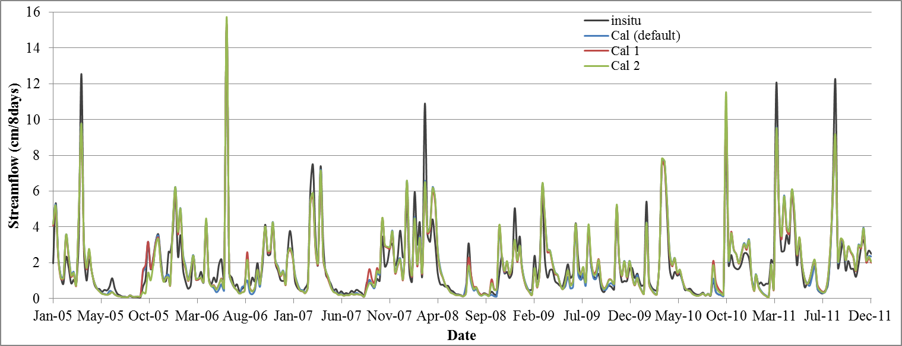
Streamflow (# scenarios)
Model Q vs. in situ Q | Calibration period (01/01/2005- 10/01/2009) | Simulation period (10/02/2009- 12/31/2011)
Default calibration | 0.775 | 0.822
Cal 1 | 0.782 | 0.821
Cal 2 | 0.779 | 0.812
CalDN1 | 0.788 | 0.825
CalDN2 | 0.784 | 0.826

Slide 14
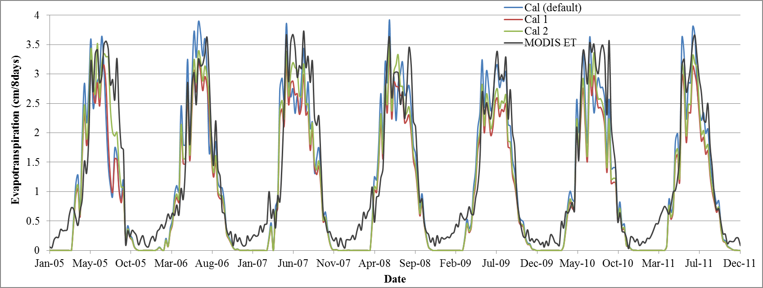
Evapotranspiration (# scenarios)
Model ET vs. MODIS ET | Calibration period (01/01/2005- 10/01/2009) | Simulation period (10/02/2009- 12/31/2011)
Default calibration | 0.645 | 0.764
Cal 1 | 0.710 | 0.750
Cal 2 | 0.755 | 0.773
CalDN1 | 0.727 | 0.753
CalDN2 | 0.767 | 0.771

Slide 15
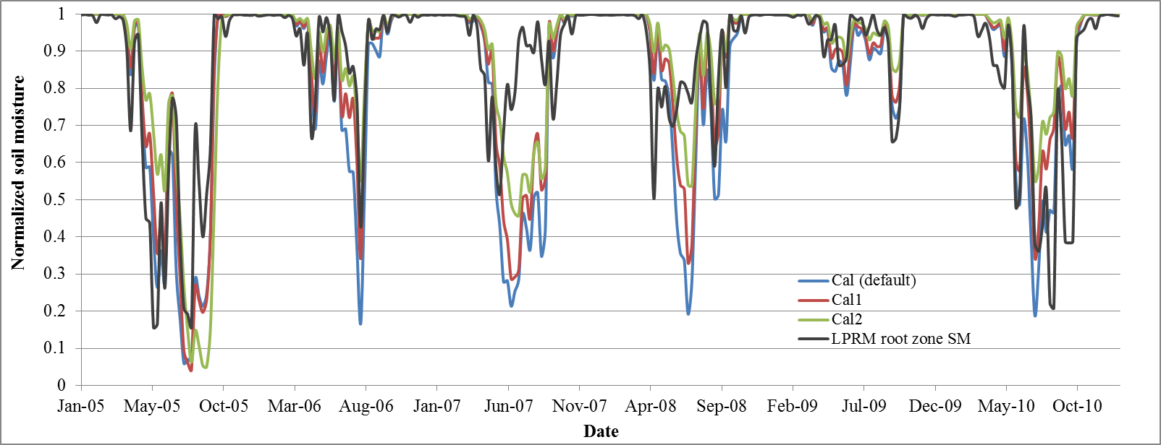
LPRM soil moisture Vs. water quantity in the unsaturated zone
 | Default Cal. | Cal 1 | Cal 2
NS | 0.32 | 0.49 | 0.41
RMSD | 0.171 | 0.148 | 0.159

Slide 16
Sensitivity to temperature change
 | Temperature + 1ºC |  | Temperature + 2ºC |  | Temperature + 3ºC
 | Q | ET | Q | ET | Q | ET
Default calibration | -0.0159 | 0.0241 | -0.0302 | 0.0461 | -0.0289 | 0.0433
Cal 1 | -0.0156 | 0.0272 | -0.0292 | 0.0517 | -0.0278 | 0.0479
Cal 2 | -0.0200 | 0.0329 | -0.0386 | 0.0642 | -0.0379 | 0.0609
CalDN1 | -0.0176 | 0.0293 | -0.0333 | 0.0560 | -0.0317 | 0.0517
CalDN2 | -0.0210 | 0.0329 | -0.0405 | 0.0639 | -0.0398 | 0.0607
New version (calibrated) model is more sensitive to temperature change
importance of an accurate hydrological model parameterization and calibration for a reliable prediction of the water supply

Slide 17
Conclusions
This work showed the benefit of the use of remote sensing data for model validation and calibration for municipal water supply management and planning applications.
These results illustrate the potential of the integration of remote sensing data into the hydrological model for better partition between different water processes within the water budget
Other remote sensing data, like soil moisture and snow properties could be also assimilated into the GWLF model.

