Slide 1
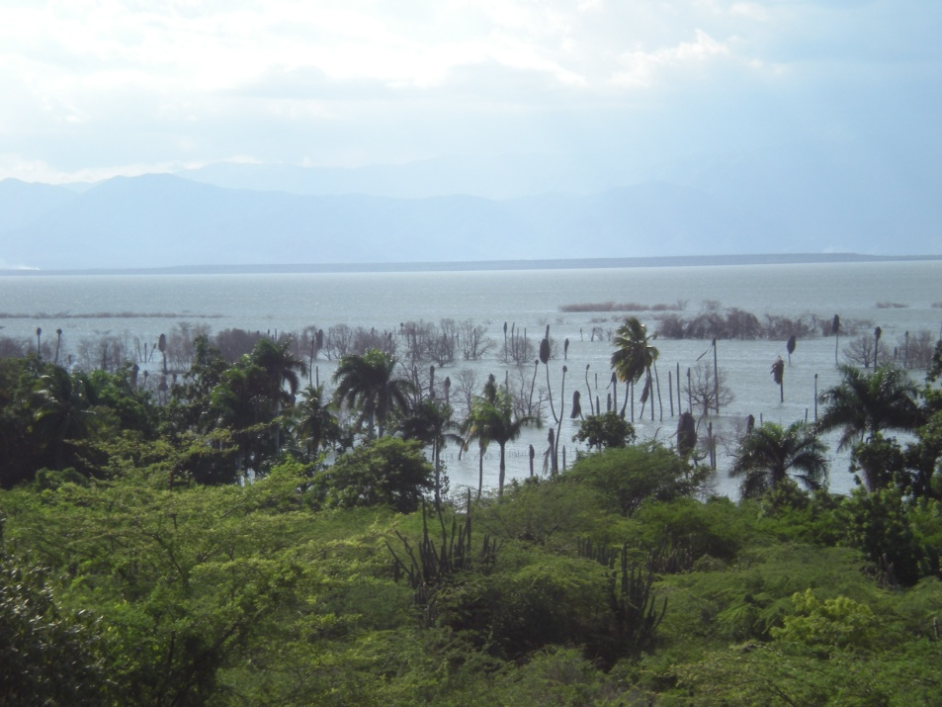



On the Changes of the Hydrological Balance of Caribbean Lakes
– Modeling and Observations
Daniel E. Comarazamy
Jorge E. González
The NOAA CREST Center of the City College of New York (CCNY)
8th Annual NOAA-CREST Symposium
New York, NY
June 5-6, 2013

Slide 2
Acknowledgements
Yolanda León, Cándido Quintana (INTEC)
Domingo Brito, Julio Román, Aury Nova (MINMARENA)
Fred Moshary, Michael Piasecki, Equisha Glenn, Adam Atia, Ksenia Shikhmacheva, Hagai Rifkind, Joseph Cleto (CCNY)
This study is supported and monitored by NOAA under CREST Grant # NA11SEC4810004, by NSF, and by the National Fund for Innovation and Scientific and Technological Development of the Dominican Republic (FONDOCYT).

Slide 3
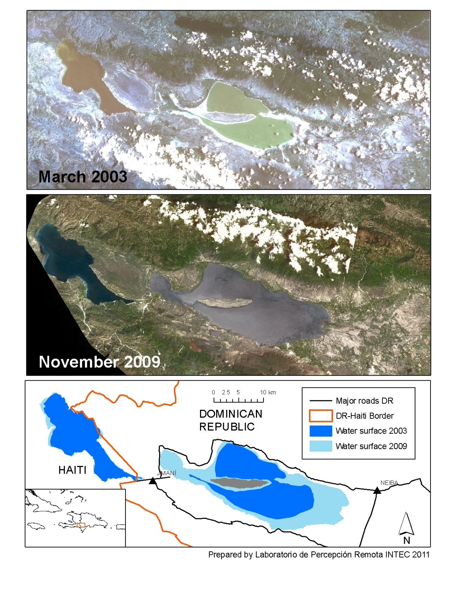
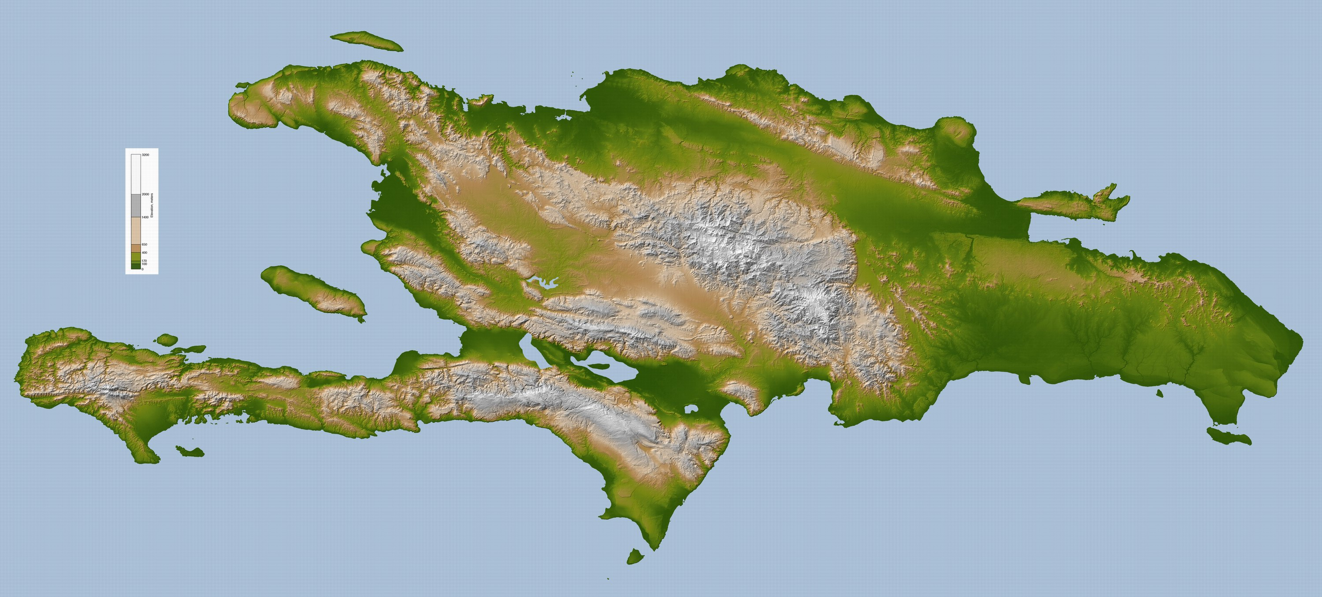
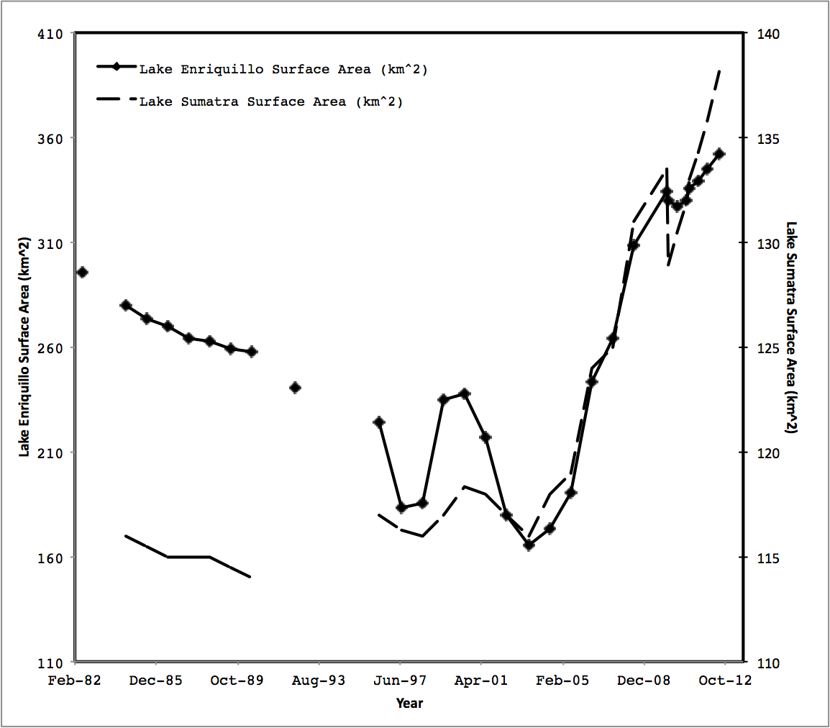
Enriquillo and Saumatre Surface Area

Slide 4
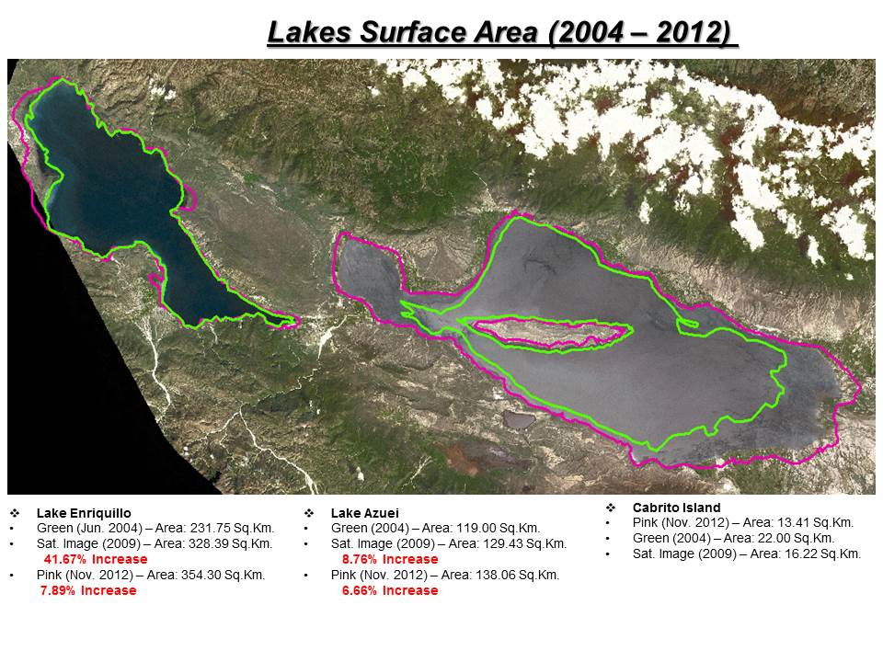

Slide 5
Summary of Lake Surface Area Changes 1984-2012
Enriquillo Saumatre
2004: 165 km², smallest rec.
2006: 276 km ², same as in 1984
2011: 331 km², 17% larger than in 1984 and 2X larger than in 2003-04.
Water level increase: ~11 m from 2003-04 to 2013
Salinity - 2013: 14ppm
  - 2003: 100 ppm
Shows a general increasing trend from 1984 to 2010
1984: 116 km²
2011: 134 km²
15.8% increased in past 25 years, 17% since 2003
Salinity – Planned for 2013
SOCIAL IMPACT
Flooding and damages of 16 communities in numerous provinces in two countries
10,000 affected farmers
Continuous lake growth enhances natural, social, and economic stresses in the region

Slide 6
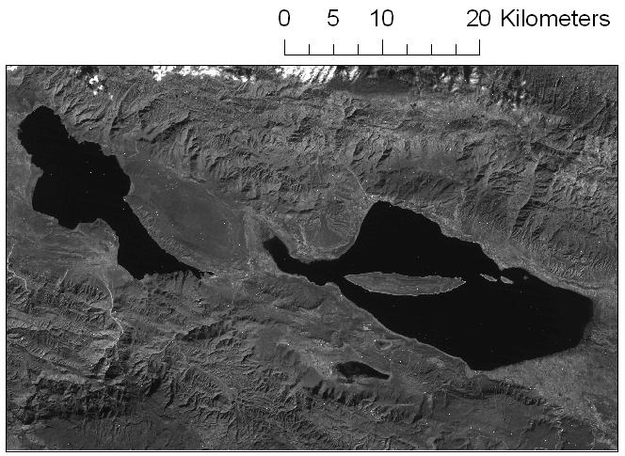
Why is the Surface Area of the Lakes Changing Dramatically?
Earthquakes cause aquifers to feed lakes at increased rates
LCLU changes increase surface runoff into lakes
Lake water level rise due to increased lake bed sedimentation
Regional and local hydro-climatic changes
Increased precipitation
Reduction in evaporation
Increase in Lake surface area
Increase in orographic water production
Increased moisture in the lake area due to increased SSTs surrounding the lake basin
Increasing runoffs due to increased precipitation and changes in use of surrounding land
Increasing fresh water production in the area due to increased horizontal rain produced mainly by orographic cloud formation in the surrounding cloud montane forests
  A combination of these factors could lead to total lake surface area increase

Slide 7
Local Observations:
Hydrological and Climate Surface Stations Location

Slide 8
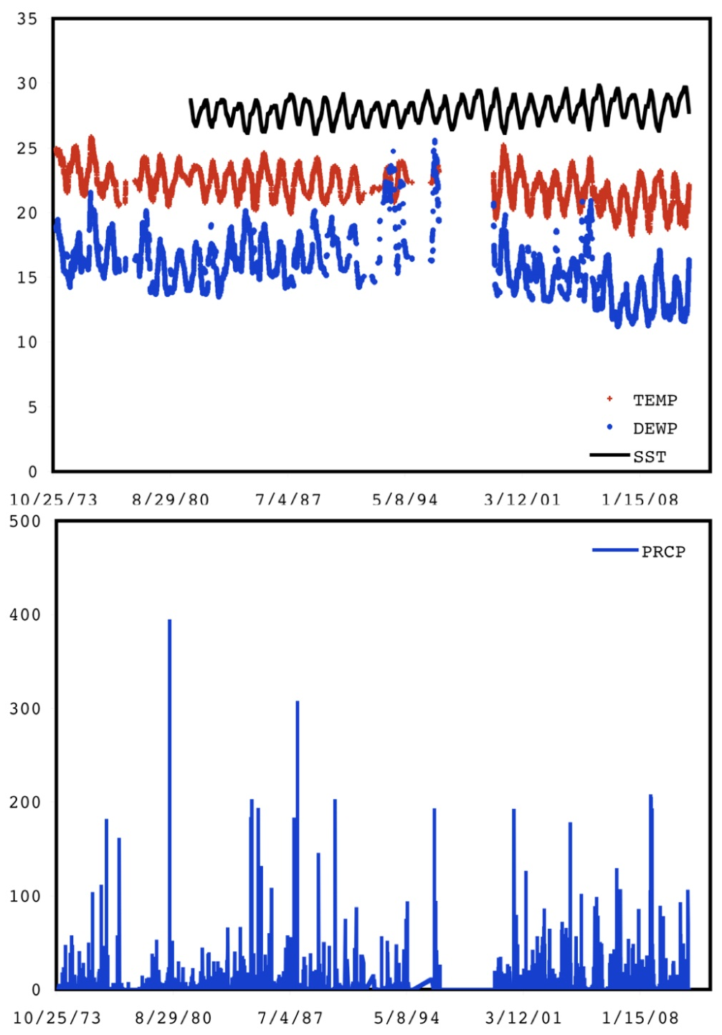
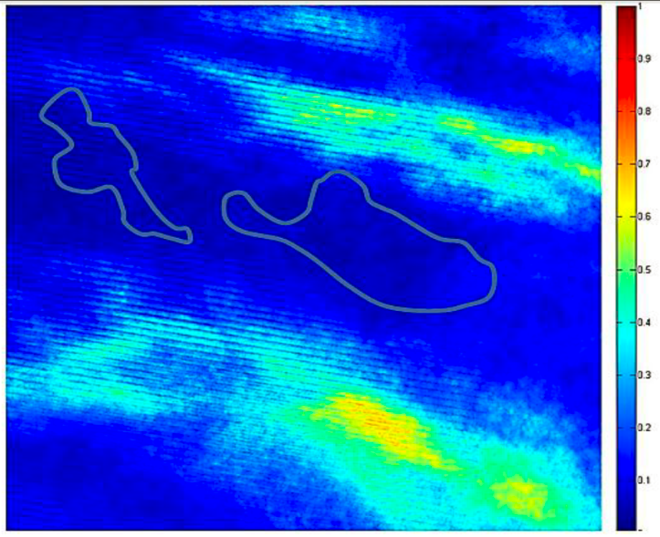
Why is the Surface Area of the Lakes Changing Dramatically?
A Hydro-Meteorology Hypothesis
Local Climate Data from COOP Station (Barahona);
SST of Surrounding Water
(Pedernales Peninsula)
Cloud Cover Frequency 2000-2010

Slide 9
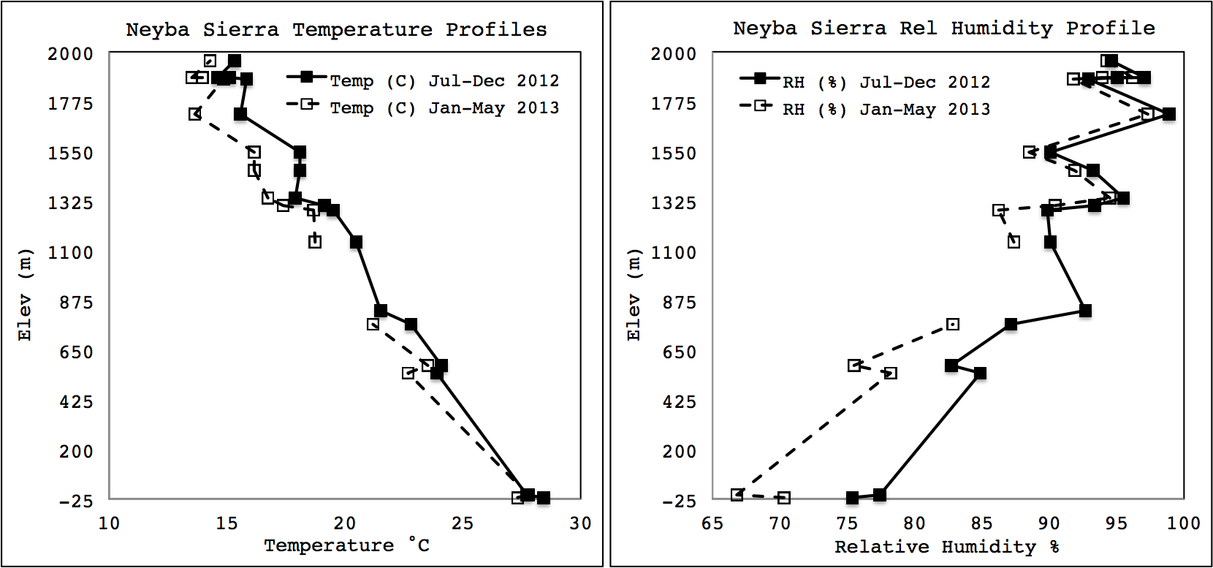
Instrumentation of the Neyba Sierra by CCNY/INTEC:
Averaged Temperature and Humidity Profiles

Slide 10
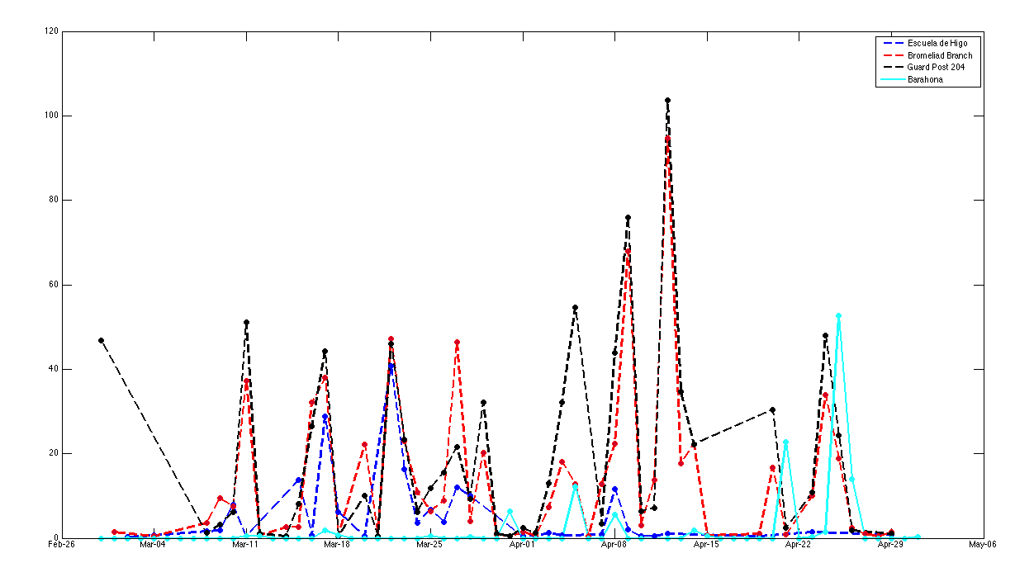
Instrumentation of the Neyba Sierra by CCNY/INTEC:
Total Daily Precipitation (mm)
Bromeliad Branch: 330 mm of water measured by Fog Gauge Jul 25, 2012 to Jun 22, 2013

Slide 11
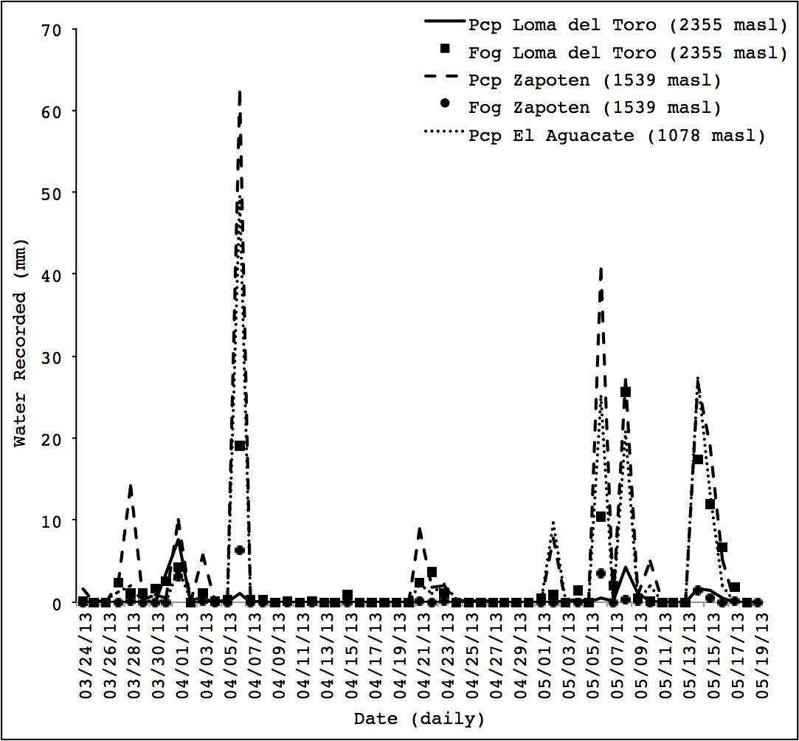
Instrumentation of the Bahoruco Sierra:
Total Daily Precipitation (mm)

Slide 12
A Hydro-Meteorology Hypothesis Tested with Integrated Atmospheric/Hydric Modeling
The regional and local observations are complemented by a set of numerical atmospheric and hydric simulations that allows the:
Generation of key variable gridded datasets;
Incorporation of climate change effects;
Incorporation of SST change effects;
Incorporation of LCLU change effects;
Generation of datasets of variables not easily measured (e.g., atmospheric liquid water content, wind patterns);
Projection of future climate conditions and lake growth.

Slide 13
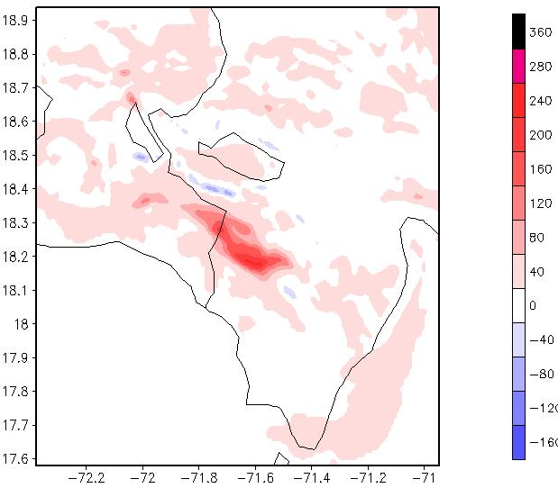
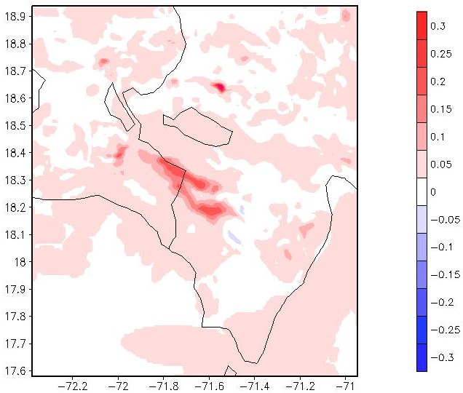
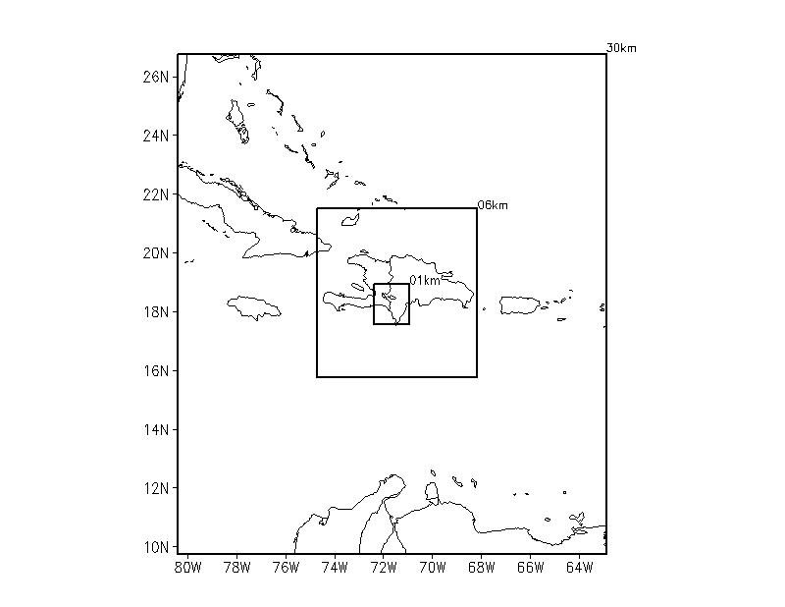
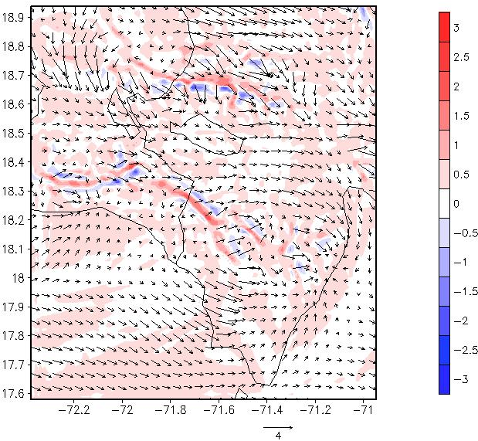
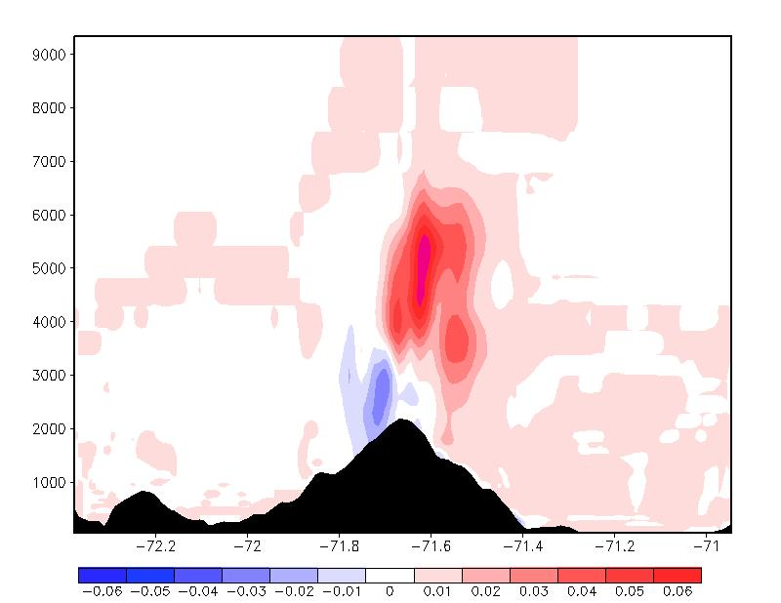
A Hydro-Meteorology Hypothesis Tested with Atmospheric Modeling:
Preliminary Results for Differences in Key Variables
Total surface precipitation and Total liquid water content between 700-1500 m
April 2010 (Growth) and 1995 (Shrinking Period)
Modeling grids showing horizontal resolution of each.
Averaged surface wind (vectors) with vertical motions (contours) and Total liquid water content along cross-section at 18.25 N Lat.

Slide 14
Upcoming exercises to complete the integrated atmospheric and hydric modeling
Atmospheric Modeling
Hydric Modeling
Perform simulation during the 3-month ERS for 1995, 2003, 2012 (full year until ERS 2013)
Model change in lake water levels performing a simple water balance of the lakes
Incorporate LCLU change into current simulations
Incorporate different SST values for the periods simulated
Perform a quantitative factor separation analysis (Stein & Alpert)
Determine statistical significance of differences found
Lake water level (m) is a function of lake volume [h = f(V)]
Perform a comprehensive hydrological modeling effort for the entire catchment area of the Enriquillo Basin

Slide 15
Future Tasks
Measurements to test the hypothesis and aid modeling efforts:
  Contribution of horizontal and potential water production
  Bathymetry for both lakes: Enriquillo completed; Azuei Planned 06/2013
  Estimate underground in/out flow
  Water salinity and temperature
Study the possible influence of increased extreme events frequency
Further analyze the correlation with increasing SSTs
Study the geological dynamics of the region to better understand and quantify groundwater flow, underground aquifers, seepage from lake beds. Working on new proposal collaborating with geologist from INTEC.

