Slide 1
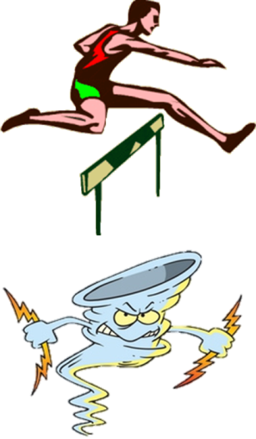


Hurtling Over Regional Observations of Extreme Weather Events while Forming
Partnerships
Dr. Mark Arend
City College of New York
NOAA CREST – Optical Remote Sensing Lab
Optical Remote Sensing Lab

Slide 2
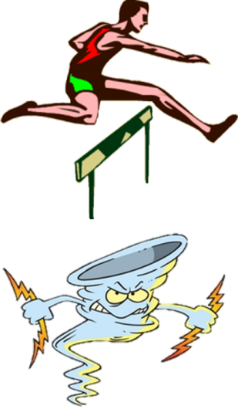
“Hurtling Over Regional Observations of Extreme Weather Events while Forming
Partnerships”
The meaning of this title and how it fits the theme of
the symposium
Chasing storms using ground based vertical profilers/surface station
Ingest and staying alive while doing it
The equipment doesn’t fall off tall buildings and could provide
information about equipment that threatens to fall
The information can be shared with partners in
a timely (real time) manner via a web portal and also be used for
reanalysis/hindecasting /validation of NWP models and other instruments

Slide 3
Collaborators and forming partnerships
CREST Partners
Miguel Lopez
Sameh Abdelazim
Tom Legbandt
Fred Moshary
Barry Gross
Sam Ahmed
Jorge Gonzalez
Estatio Gutiérrez
CREST/CCRUN Partners
Reza Khanbilvardi
Maryam Karimi
Brian Vant Hull
CCRUN Partners - Columbia University (Health Team)
Stevens Institute of Technology (Alan Blumberg, Philip Orton, Talmor Meir, Julie Pullen)
Agency Partners
NOAA
DHS
EPA
NRL (COAMPS)
CUNY IHPCC
UAOA
Urban Atmosphere Ocean Observatory

Slide 4
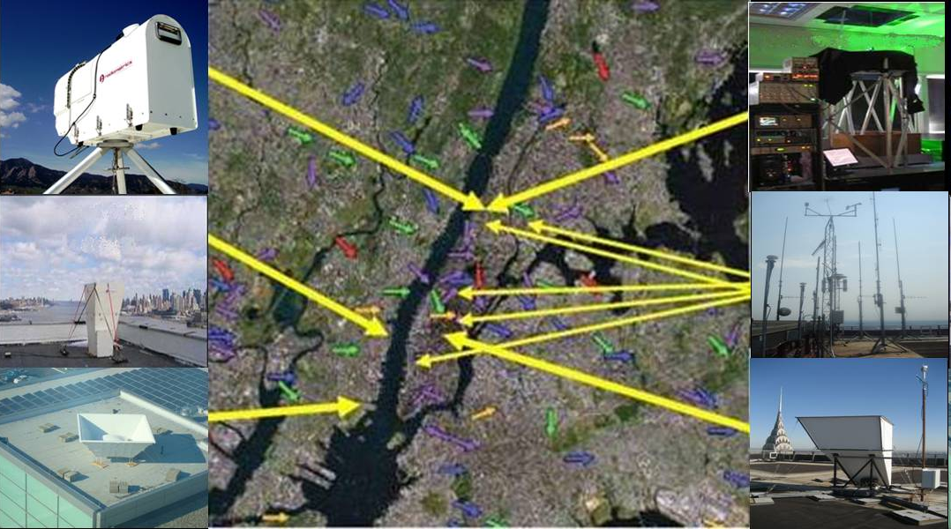
NYCMetNet
Vertical Profilers and Surface Stations
None of the CCNY Operated Rooftop Equipment was Compromised by SANDY/IRENE
Info available on http://nycmetnet.ccny.cuny.edu/
a
d
b
e
f
c
Hyper spectral radiometer
Sodar to 300 m
Radar Wind Proifiler to 2 km
d) Backscatter aerosol Lidar
e) Building top Met Tower
f) Sodar to 400 m

Slide 5
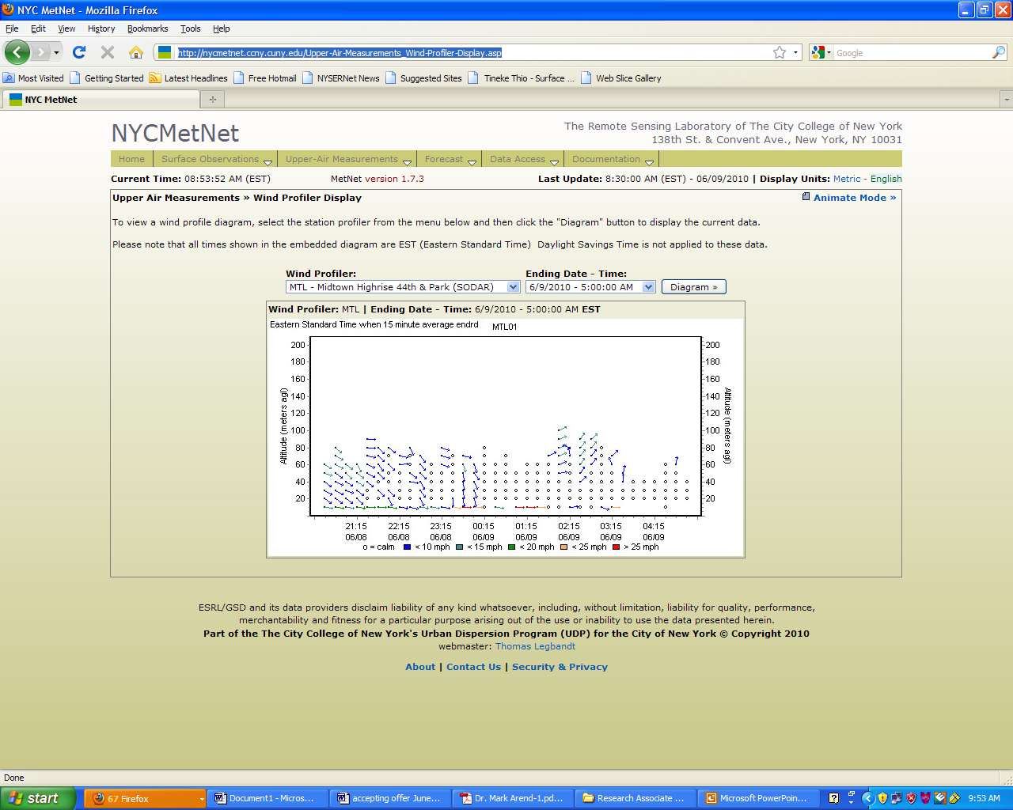
NYC MetNet Web site
http://nycmetnet.ccny.cuny.edu

Slide 6
Focus on extreme event case studies
Summer Heat Waves
Hurricanes Sandy and Irene

Slide 7
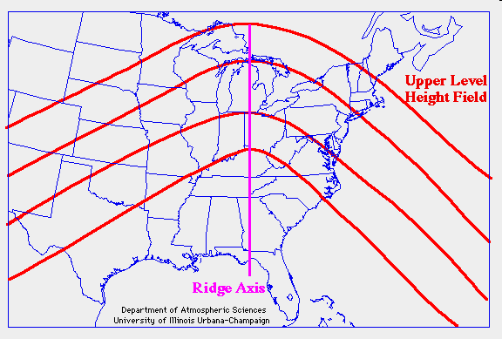
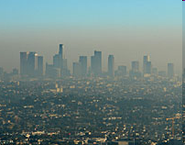
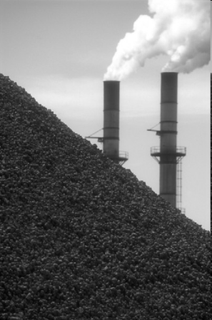
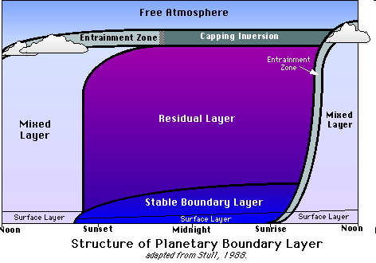
The Perfect Storm for Bad Air Quality
During Hot Summer Days
Meteorological Conditions
Planetary Boundary Layer
Societal Reaction
Indoor Air Cooling
Upper Level Ridge
Sinking air masses
High Pressure
No Clouds
Higher temperatures
“Mixed layer” does not mix much
(low to ground level)
Peak Energy Demands Require
More Fossil Fuel Burning

Slide 8
Heat Wave Event June 8, 9 and10 of 2011
Central Park Temperatures (degrees F)

Slide 9
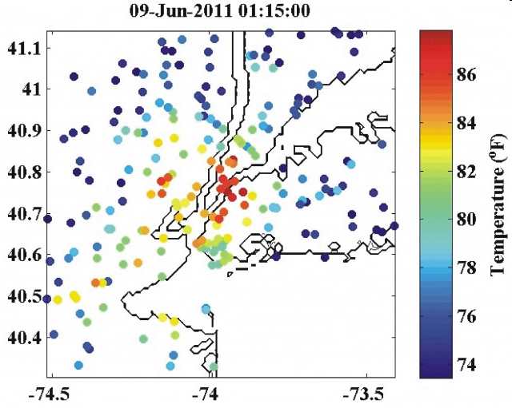
Air temperature measurements (from NYCMetNet) at 1:15 AM during a recent heat wave.
The 240 weather stations demonstrate how some neighborhoods around
New York City were as much as 15 degrees warmer than rural areas.

Slide 10
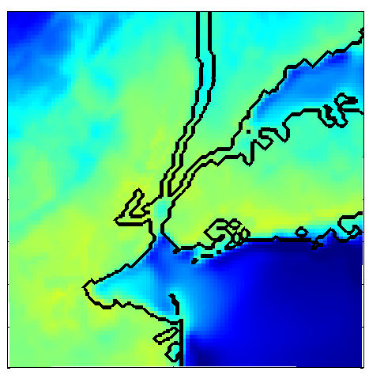
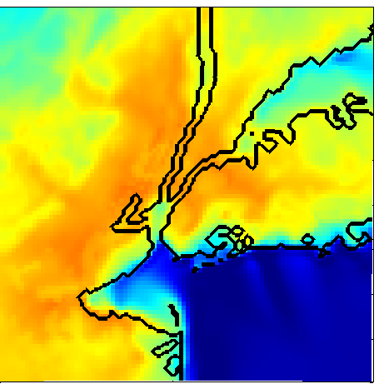
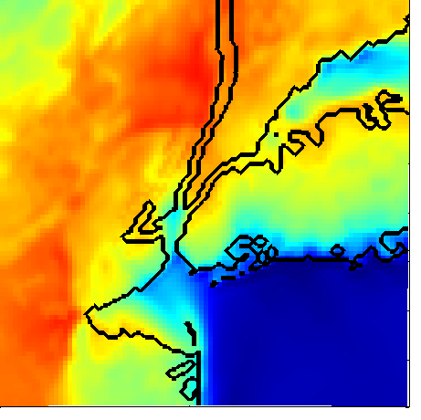
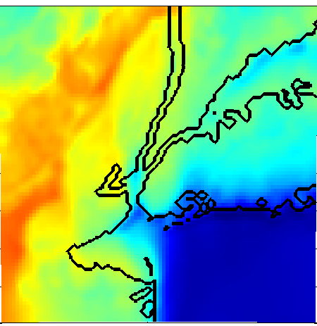
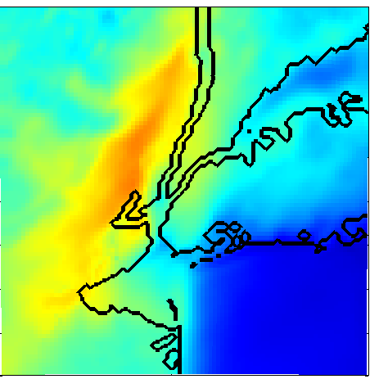
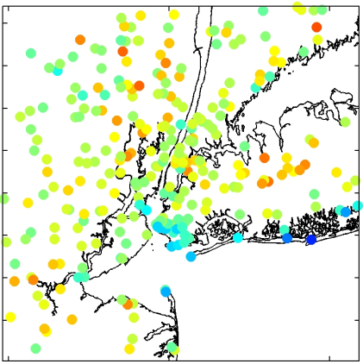
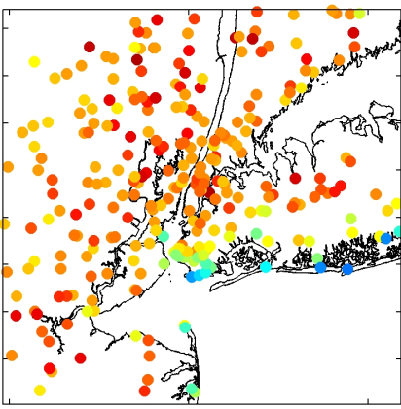
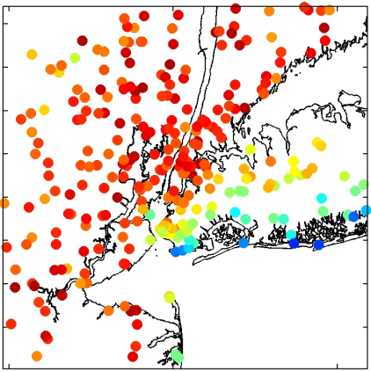
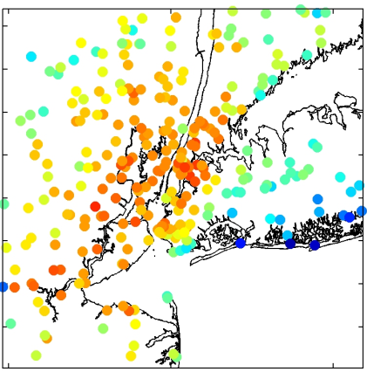
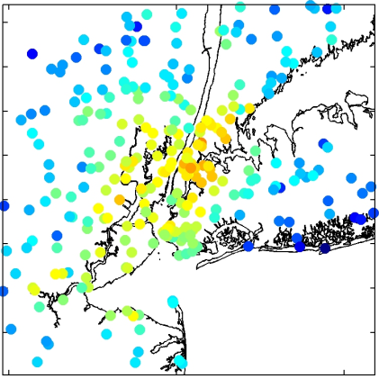
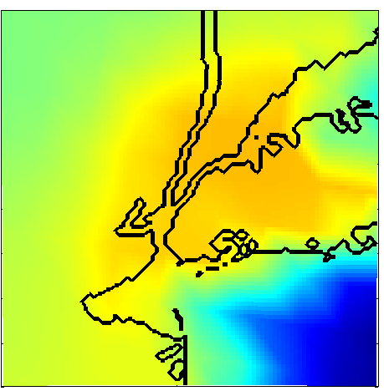
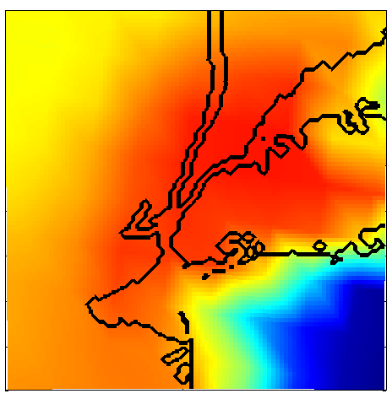
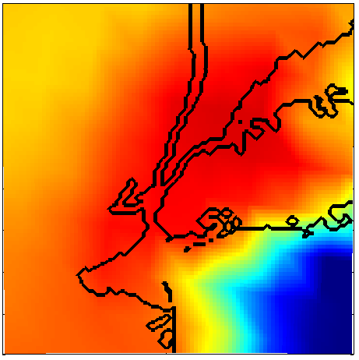
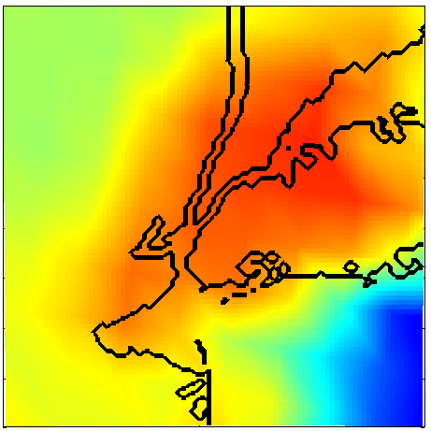
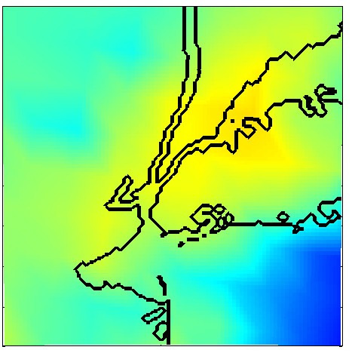
June.8 EST
10 meter air temperatures
11:00
14:00
17:00
20:00
23:00
1 km COAMPS
Obs
12 km NAM
Notes:
10

Slide 11
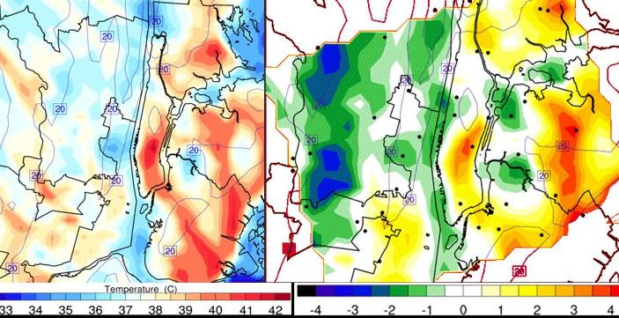
CCNY 0.33 km grid spacing uWRF compared against kriged NYCMetNet observations
Surface temperature distribution (left) and differences between modeling and observation (right) at 1500 LST July 6th during the heat wave event that took place July 5th-7th, 2010 in NYC Metro Area. The small errors between model and observations in mid and downtown areas represent a significant improvement over existing modeling capabilities.

Slide 12
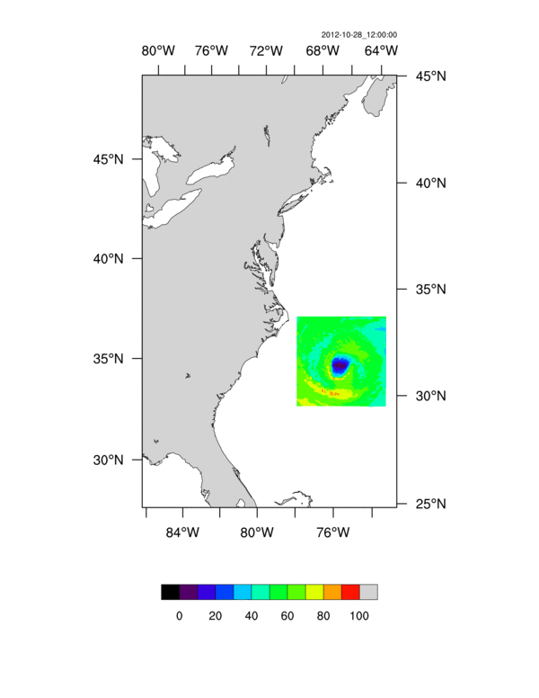
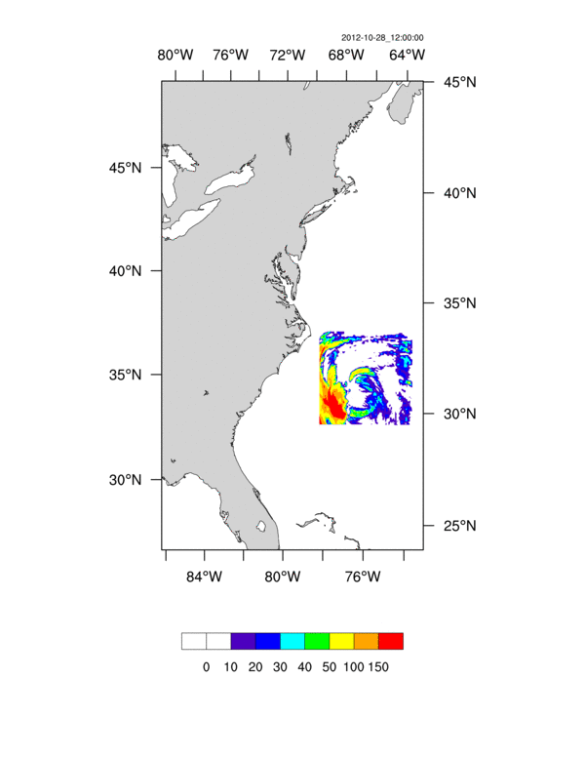
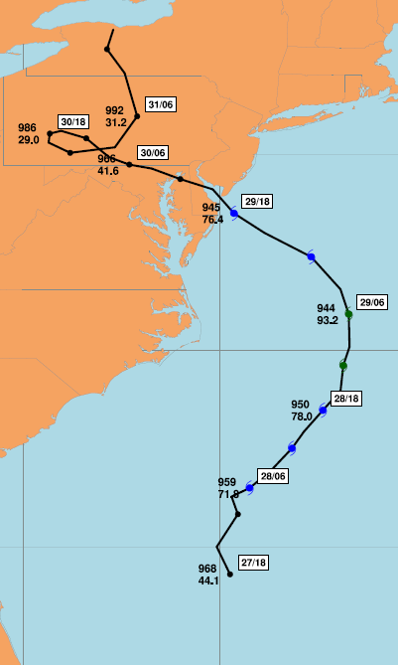
CCNY/uWRF Hurricane Sandy path, wind speed (MPH) and 6-hr accumulated precipitation (mm). 24 hr spin-off, 72 hrs forecasting. NAM input, 10hrs of simulation. Improved surface drag/turbulence due to better representation of land and associated dynamics.

Slide 13
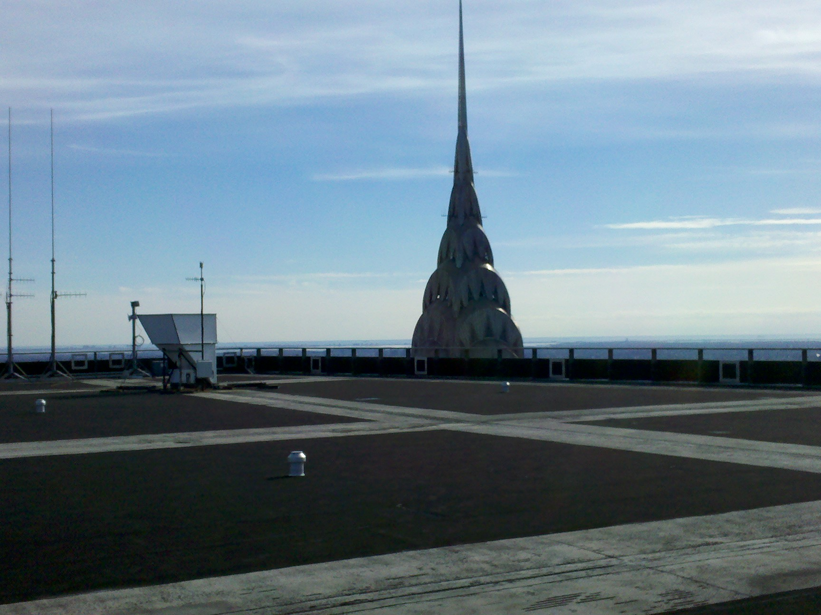
NYCMetNet instruments on top of Midtown Manhattan 58 story Building
Sonic Anemometer 250 m above ground level
SODAR

Slide 14
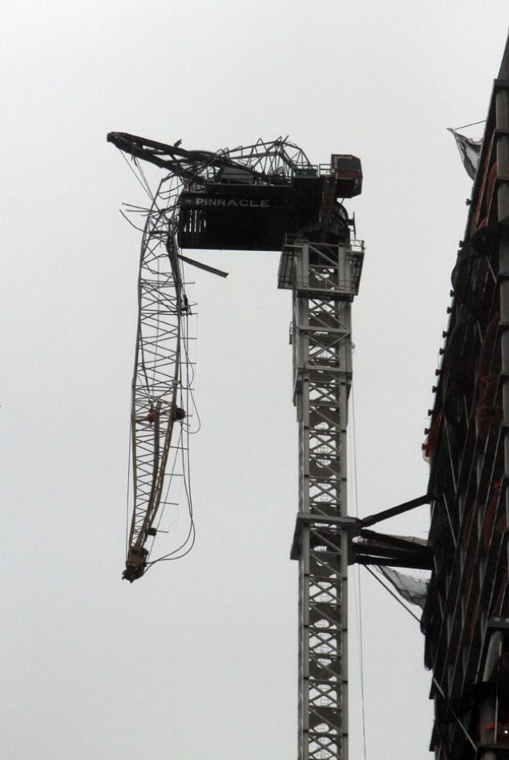
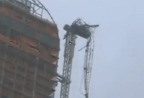
Dangling Crane
Top of a skyscraper at 157 W. 57th St. in Manhattan.

Slide 15
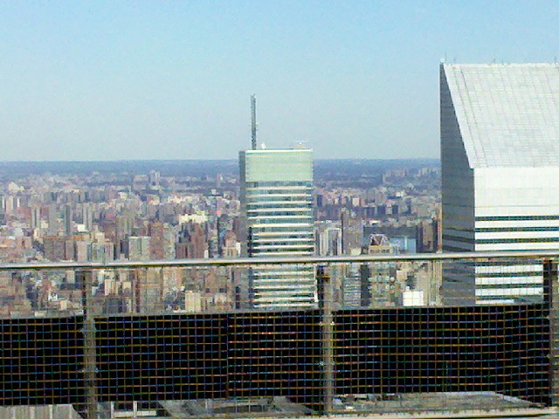
View of Crane 13 blocks North of Metlife building (246 m high)

Slide 16
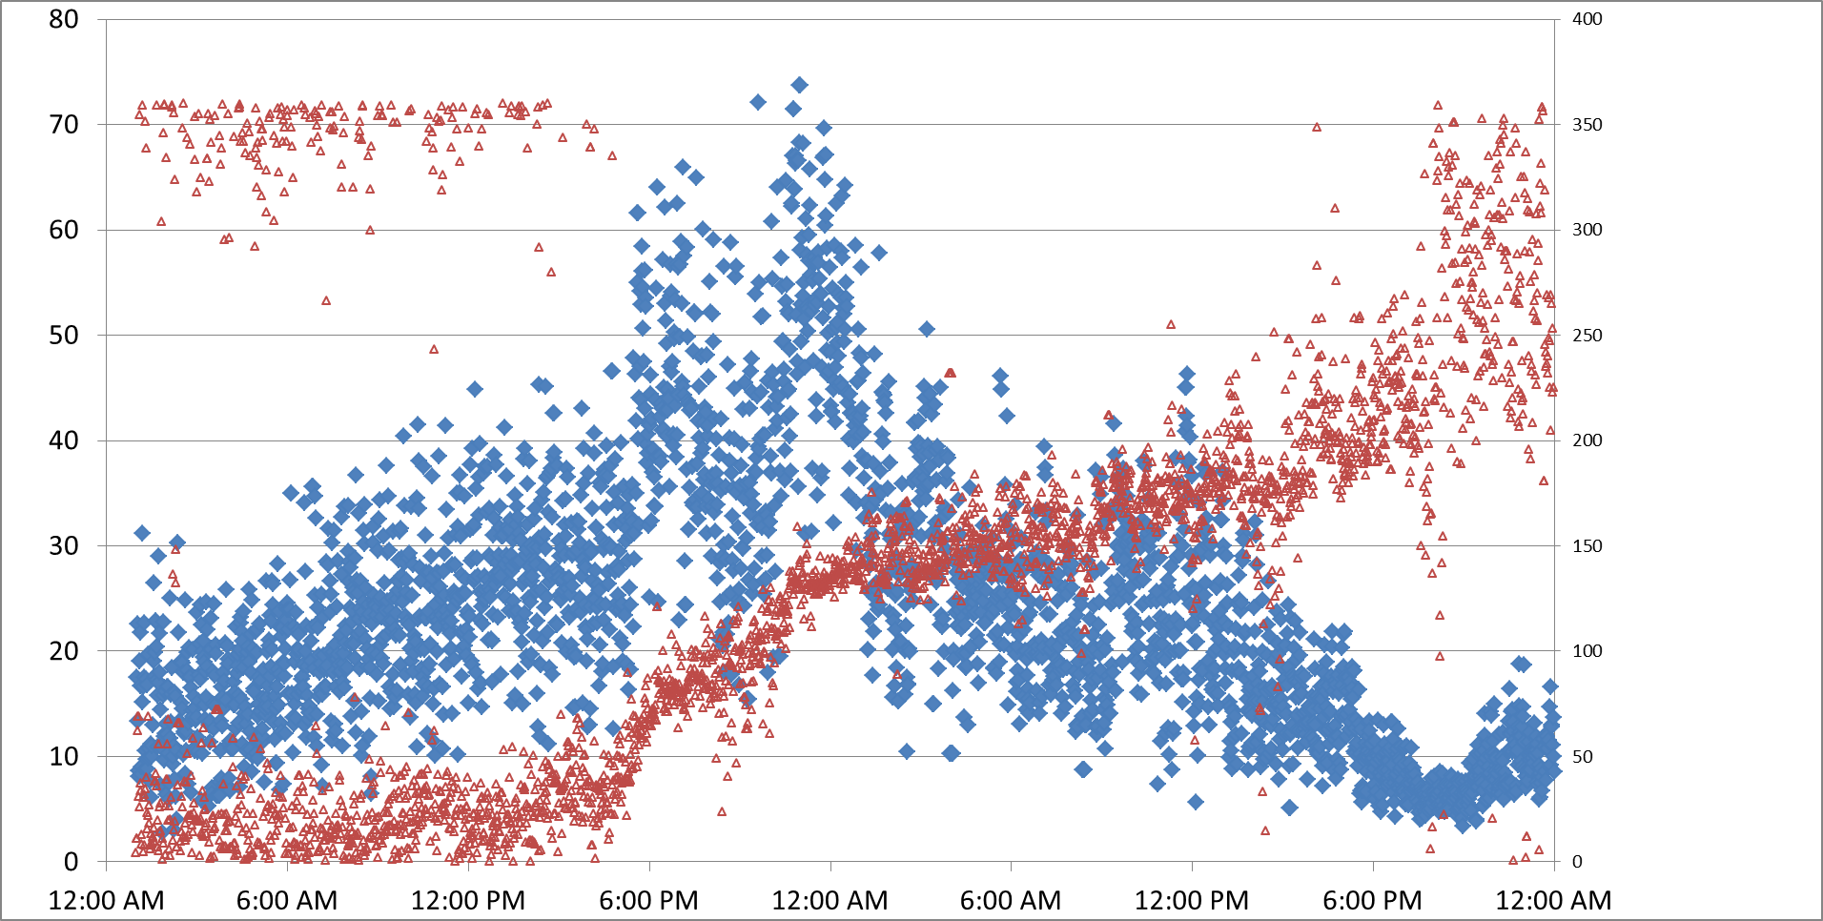
One minute averaged rooftop wind speed
250 m above ground level
Crane collapses at this time (2:30 PM October 29th)

Slide 17
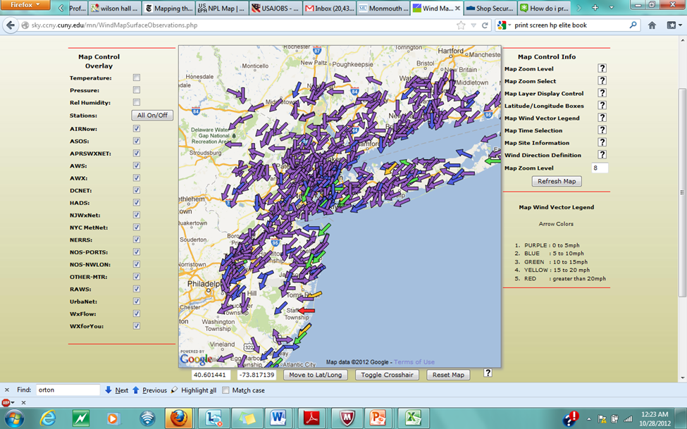
NYCMetNet Screen Shot 12:10 AM October 28th

Slide 18
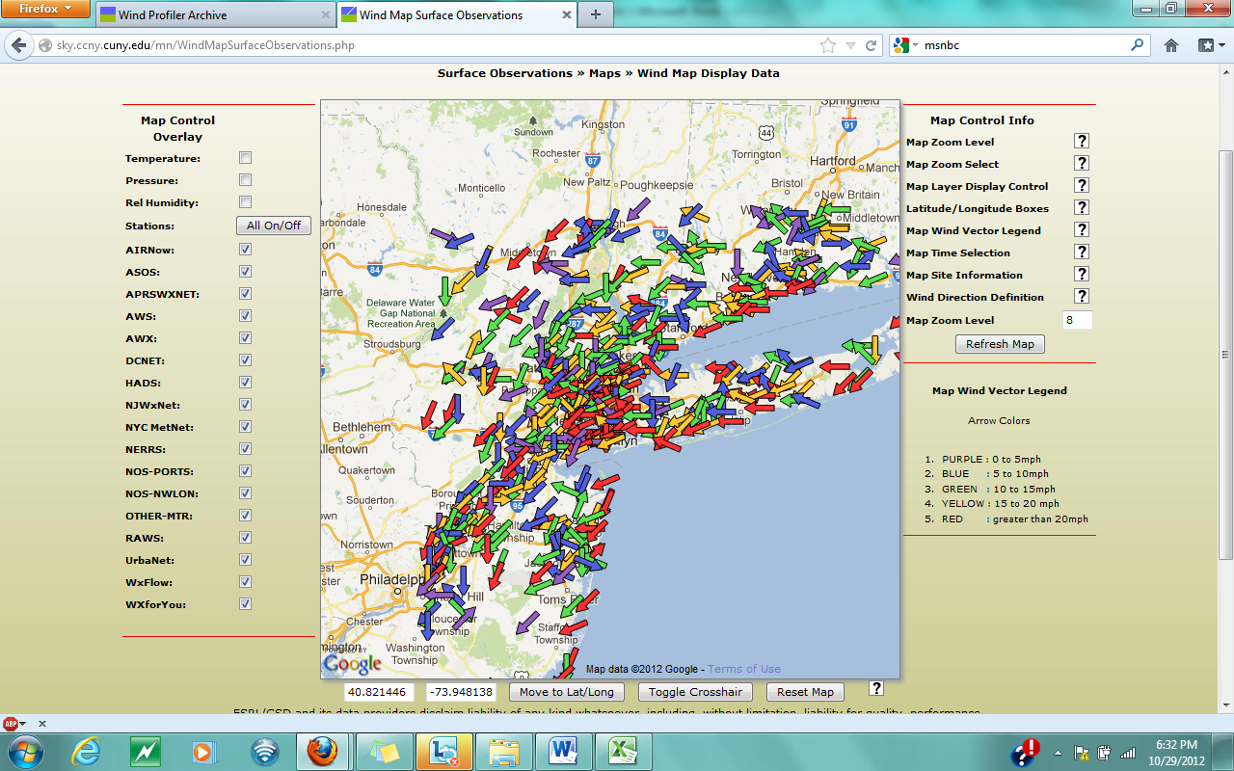
NYCMetNet Screen Shot 6:32 PM October 29th
The power goes out shortly after taking this last screen shot

Slide 19
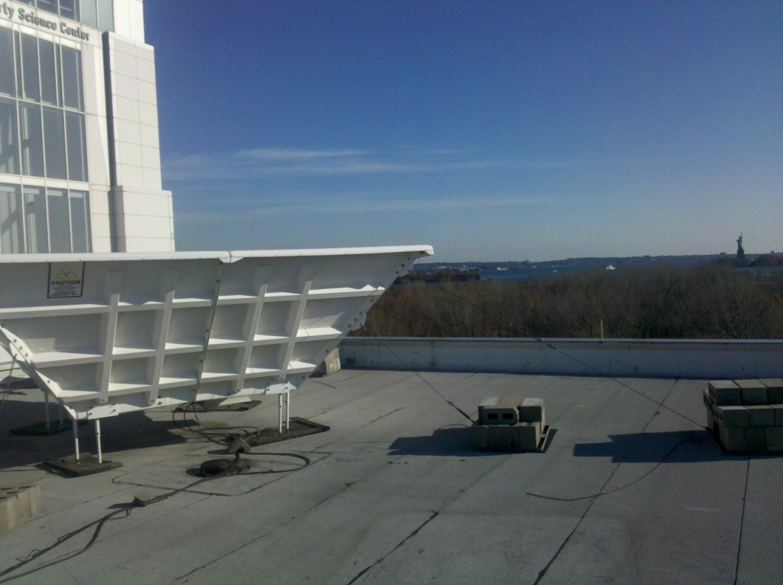
Peak record sustained wind (1/2 hr average)
using ground based remote sensing
Speed: 125 mi/hr
Time and date: 3:30 PM Oct 29
Height: 1.65 km above ground level
Instrument: Radar Wind Profiler
Location: Liberty Science Center, Jersey City
Statue of Liberty

Slide 20
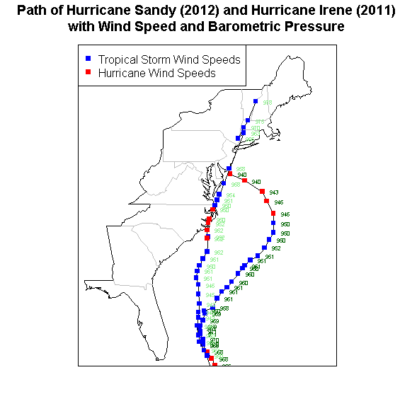

Slide 21
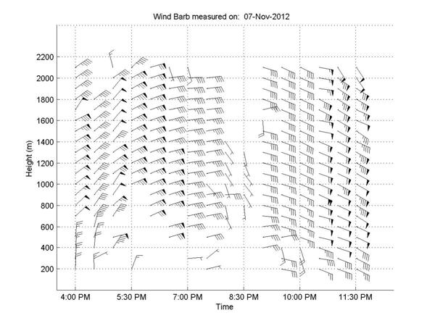
Hurricane Sandy Wind Barbs Measured by NYCMetNet
Radar Wind Profiler, Jersey City, NJ (Oct. 29, 2012)
North
7
6
5
Height above ground level (thousands of feet)
4
3
2
1
6:00 PM
9:00 PM
Time of day (EDT)
Max Speed: 125 mi/hr
3:30 PM Oct 29
Height: 1.65 km AGL

Slide 22
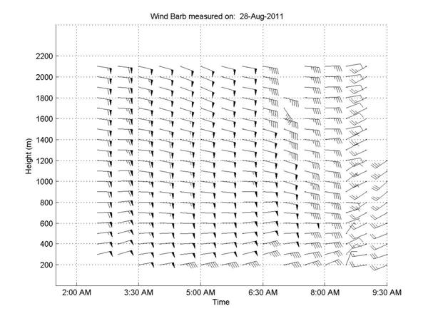
Vertical Wind Profiler Observation of Hurricane Irene
sustained horizontal winds (averaged over ½ hour period) were
71.7 knots (82.5 miles per hour) at 1,800 meters above the surface

Slide 23
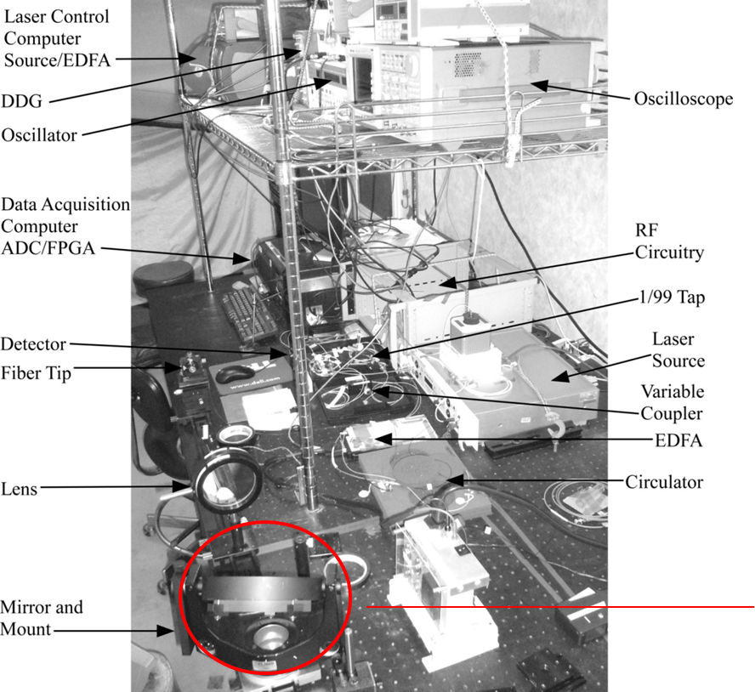
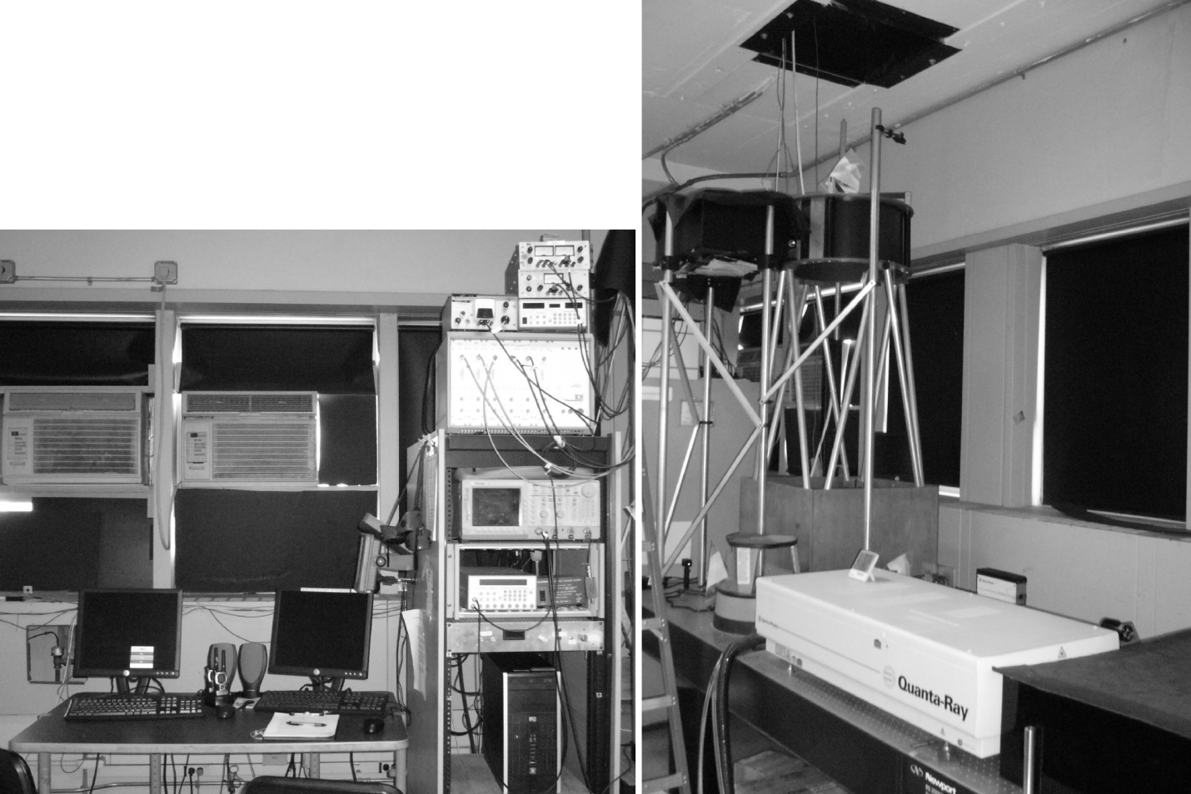
Comparison of two lidar systems developed at CCNY
Detection, control, data
storage equipment
Telescope, laser, optics
Scanning mirror

Slide 24
Comparing Two Wind Lidar Signal Processing Techniques
Technique 1:
Acquire a time series of the return signal for each pulse
Separate return signal in to intervals
Perform a FFT on each interval
Take square modulus of FFT
Accumulate result from many pulses to improve SNR
Technique 2: (use the Wierner-Khinchin theorem)
The Fourier transform of the autocorrelation is equal to
the power spectrum
Acquire a time series of the return signal for each pulse
Manage data flow by demodulating, filtering and downsampling
Produce an M-lag autocorrelation matrix
Accumulate matrix from many pulses to improve SNR

Slide 25
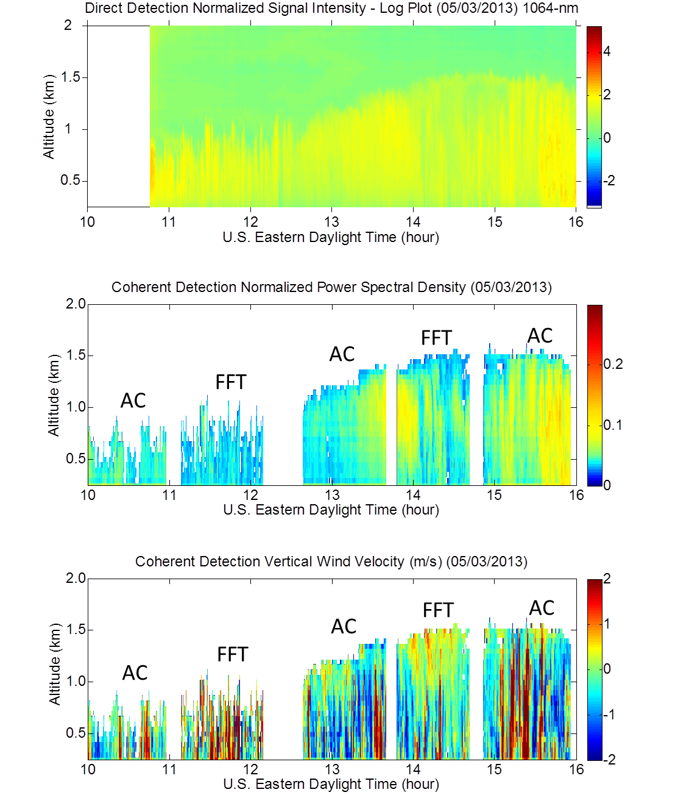

Comparing Lidar vertical profiles (Direct/Coherent) and Comparing Signal Processing (AC/FFT)
Key Points
Consistent boundary Layer growth
Aerosol concentrations track
AM turbulent activity agreement
Advanced post processing possible
Potential application to combine
vertical velocity profile with
radiometer water vapor profiles
to calculate covariance
profile and obtain latent heat
flux vertical profile
(extension of eddy covariance technique)

Slide 26
Conclusion
Case studies of observed heat waves and hurricanes have been presented
Current capacity of a research grade Urban Observatory composed of multiple
Instruments is highlighted and examples of instrument inter-comparisons are given
Partnerships are being developed to extend the Observatory to integrate
both monitoring and modeling of the regional (NY/NJ) atmospheric boundary layer
Chasing storms is fun but make sure you run the right way at the right time

